Slide 1
Roman Republic

Slide 2
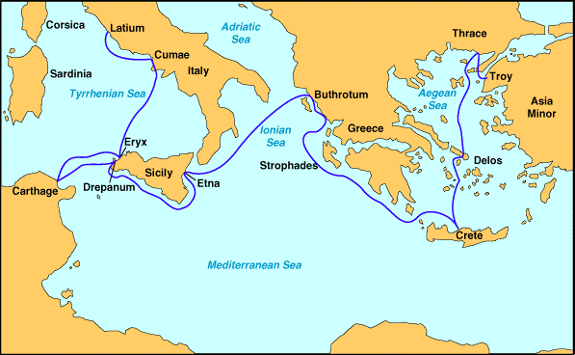
Founding of Rome – The Roman Race
The tale of Aeneas (The Aeneid)
Dido at Carthage and other travels (like The Odyssey)
Historical evidence
Settlements from 11th Century BC

Slide 3
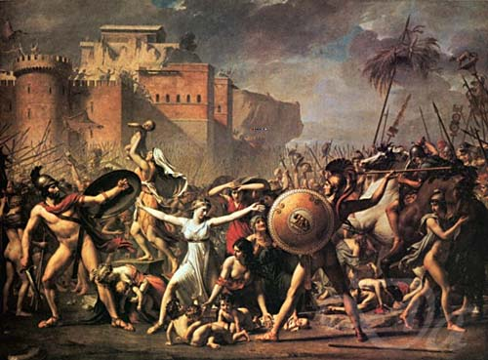
Founding of Rome – The Roman Race
Wars against the Latins (like The Illiad)
Rape of the Sabine Women (Jacques Louis David)

Slide 4
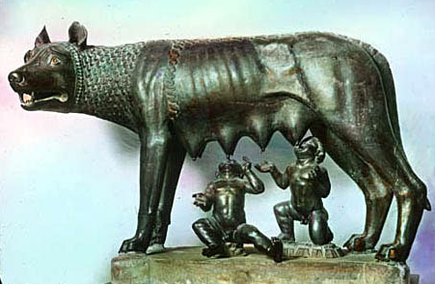
Founding of Rome – The City (Kingdom) of Rome
Romulus and Remus
Latin princess was Vestal virgin
Raped by Mars, bore twin boys
Ordered killed by non-Latin king
Suckled by a wolf
Grew and founded a city (753BC)
Romulus killed Remus
Historic Evidence
The Etruscans conquered the Romans (non-Latin king)
Romans eventually overthrew Etruscans and established kingdom
Ruins of home of king (Romulus?) date from 8th Century BC

Slide 5
Regal Period
Began with war of independence from Etruscans (500 BC)
War heroes exhibit desired qualities of Romans
Horatio at the bridge (Oath of the Horatii by Jacques Louis David)
Stories became legends for Romans throughout their history
Compare to American War of Independence
Regal period
Ruled by 7 kings
Revolted against last king to found the republic

Slide 6
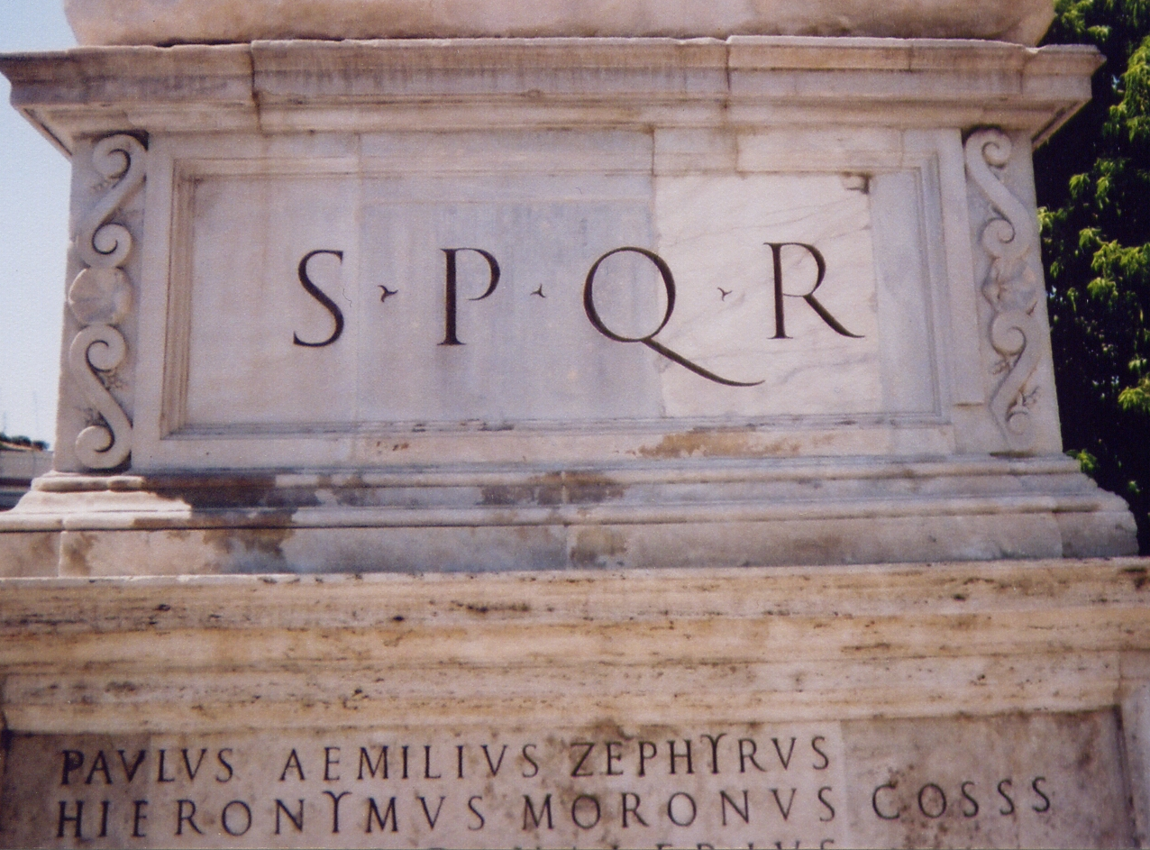
Republican Government
Ruled by a senate and the people
SPQR= Senate and the People of Rome
Senate (patricians) appointed consuls (1 year)
Foreign affairs and the military
Direct access by the people to the consul
People (plebs) organized by tribes and they elected 10 tribunes
Governed local affairs
Had veto power (individually)

Slide 7
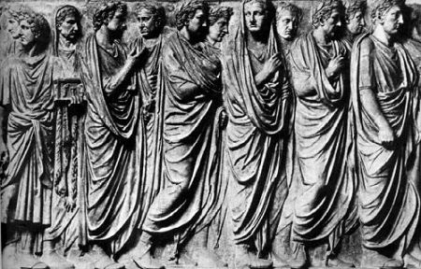
Constitution (balanced power)
Senate
Never made laws but advice was accepted
Had power to appoint a person to solve a specific problem (He was a "speaker" or "dictator")
Appointed censors (moral guardian/rank judge)
Appointed governors
Concilium plebis
Made all the laws (called plebecites)
Elected magistrates (administrators) and judges
Comitia Curiata/Centuriata – plebs and patricians
Committed the emporium (military power)
All met in the forum (looked over each other)
Pontifex Maximus
Religious leader

Slide 8
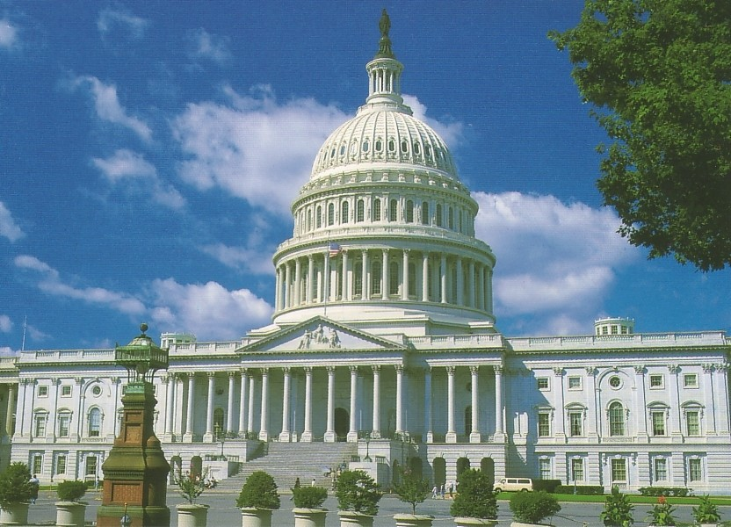
Government
Comparisons with US government
Balance of power
Senate and House of Representatives
Consul (= president)
Tribune (veto power)
Courts (independent)
Military power (?)
Censor (?)

Slide 9
Military Organization
Centuries — 100 armed men
Headed by Centurian (from the ranks)
Maniples—3 Centuries
Could move quickly through difficult terrain (better than phalanx)
Independent decisions (tribunes)
Legions—groups of Maniples
6000 men
Supported by light cavalry
Discipline
Death for individual insubordination
Decimation for cowardice

Slide 10
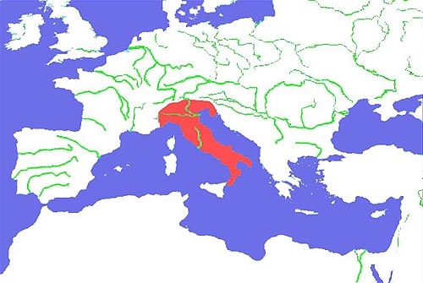
Roman Expansion (in Italy)
Conquest of Italy
Took 200 years
Granted full or partial citizenship
Tax and legal benefits
Developed loyalty in conquered Italian areas
Invasion by King Pyrrhus (pyrrhic victory)
Roman colonies
Established in strategic locations
Established by treaty
Troops sent when needed
Customs of the area left intact
Colonies were mostly for trade, with some military purposes

Slide 11
Roman Expansion (outside Italy)
Punic Wars
Phoenicians (Poeni)
Sicily
Hannibal attacked Rome
Help of non-Roman Italians(?)

Slide 12
Roman Expansion (outside Italy)
Conquest of the East and West
Allies rather than servants or slaves
Toleration
Corruption in the Greek kingdoms
Some states given to the Romans
Fast, direct attacks with strong determination and discipline
Outnumbered in most battles
Victory over Parthia (parthian shot)

Slide 13
Building an Empire
Structure of the "empire"
Still a republican form of government
Checks and balances
Two parties emerged
Optimares (conservatives, Cato and Cicero)
Populares (power to people)
Family
Values (according to the Romans)
Piety
Discipline
Frugality
Not greedy
Righteous wars
Never quit

Slide 14
Building an Empire
Status of Women
Absence of men at war
Women gained economic power
Ability to divorce and retain property
Morals eventually eroded, in part because home-life eroded

Slide 15
Building an Empire
Slavery
Conquests increased the number of slaves
Constituted 40% of the population
Conditions were poor
Romans feared slave uprising
Slaves took jobs from the plebs so plebs were given food and other benefits

Slide 16
Collapse of the Republic
Gracchus brothers
Violence used to impose one's will
Marius
Re-election to consulate (many times)
Standing army
Sulla
Assumption of dictator powers
Use of the army to override councils
Proscription list

Slide 17
Julius Caesar 100-44 BC
Early Life
Born to aristocratic family
Caesarian section
Legend that he descended from the gods
Known for partying and sexual appetite
Captured by pirates and held for ransom
Returned to area and killed pirates
Appointed to a series of government jobs
Statue of Alexander

Slide 18
Julius Caesar
Triumvirate
Praised for his work in Spain
Appointed governor in Gaul (conquest)
Alliance with Crassus and Pompey to form the triumvirate (not initially, but later elected)
Rivalry with Pompey after death of Crassus
Crossing the Rubicon
Uprising in Asia
Veni, vidi, vici—I came, I saw, I conquered
Conquest of Egypt
Cleopatra

Slide 19
Julius Caesar
Returned to Rome as a conquering hero
Procession for each territory on a different day (Gaul, Africa, Spain, Asia) and games for many additional days
Offered crown (as emperor) twice and refused it when people didn't respond favorably
Dictator (rule by one man)
Appointed for 10 years and then for life
Caesar’s plans for Rome
Calendar (July)
Libraries, theaters, other public works
Gave citizenship to people in Spain and Gaul

Slide 20
Julius Caesar
Murder of Caesar
Killed by senatorial opponents
Instigated by his usurpation of power and their fear that he would become emperor
Died March 15, 44 BC
Stabbed by 20 senators
Brutus—illegitimate son
Mark Anthony and Octavian
Rallied against the conspirators

Slide 21
Thank You

Slide 22
Collapse of the Republic
Violence used to eliminate enemies and impose one’s will
Gracchus
Re-election to consulate (many times) and standing army
Marius
Assumption of dictator powers, use of the army to override councils, proscription list
Sulla

Slide 23
Roman Republic
Rome conquered Greece 150 BC
Romans took on much Greek culture
Gods and goddesses parallel each other
Gods had Indo-European roots

Slide 25
Conquests
Other areas
Conquest over other powers and then direct conquest to subdue the local tribes
Conquest continued through republic and empire period.
(Asterix and Obelisk)

Slide 26
Building an Empire
Economics
Not enough land to support the people
Farmers were needed and respected
Acquisition of wheat and other foods became a priority
Victory over Carthage provided more land
Rome was a consumer
Trading profits made many Romans rich
Extremes of wealth and poverty
Citizens did not have to pay taxes

Slide 27
This powerpoint was kindly donated to www.worldofteaching.com
http://www.worldofteaching.com is home to over a thousand powerpoints submitted by teachers. This is a completely free site and requires no registration. Please visit and I hope it will help in your teaching.

